Slide 1
Machine Learning for
Geo-Science
Amir Baqerzadeh
Summer 2025

Slide 2
Objectives
1) What is Learning?
2) What is Machine Learning?
3) Steps in machine learning.
4) Types of machine Learning.
5) Applications of Machine Learning.

Slide 3
What is Learning?
“To gain knowledge or understanding of, or skill in by study, instruction or experience''
Learning a set of new facts.
Learning HOW to do something .
Improving ability of something already learned.

Slide 4
What is Machine Learning?
Machine Learning is the study of methods for programming computers to learn.
Building machines that automatically learn from experience.
Machine learning usually refers to the changes in systems that perform tasks associated with artificial intelligence AI Such tasks involve recognition, diagnosis, planning, robot control, prediction, etc.

Slide 5
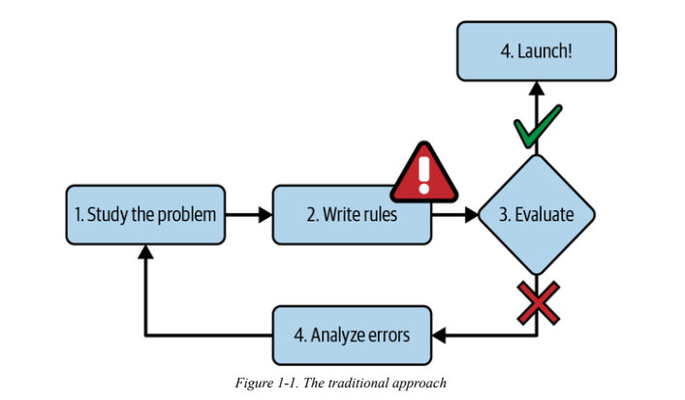
What is Machine Learning?

Slide 6
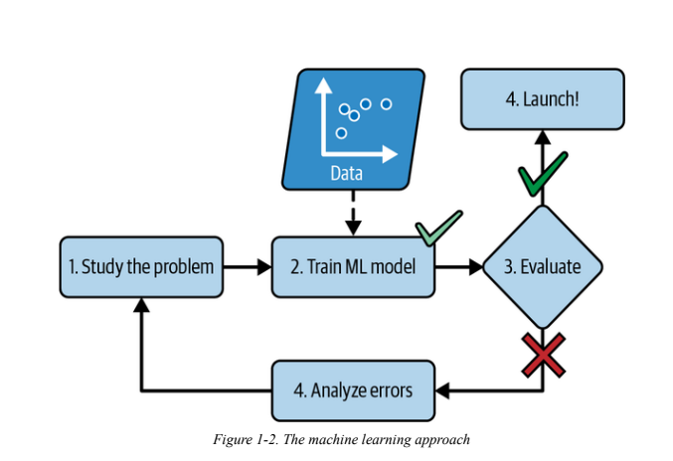
What is Machine Learning?

Slide 7
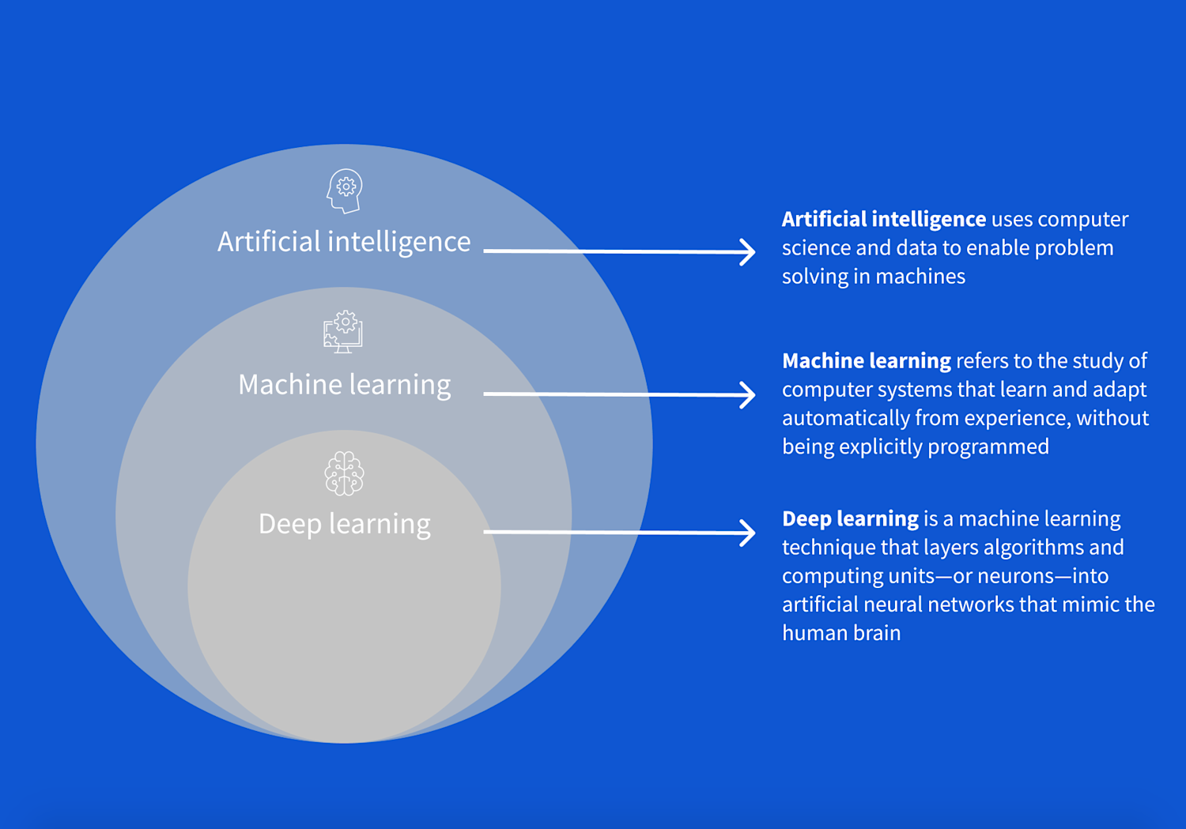
What is Machine Learning?

Slide 8
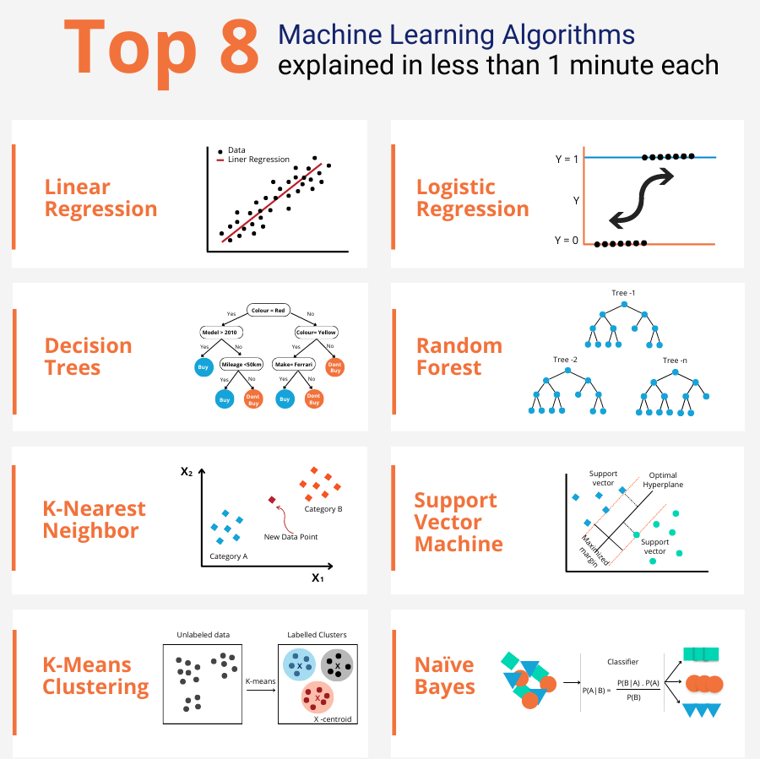
What is Machine Model?

Slide 9
Steps in machine learning
Data collection.
Representation.
Modeling.
Estimation.
Apply Leanred Model to new “test” data
Validation
Deploy the Model

Slide 10
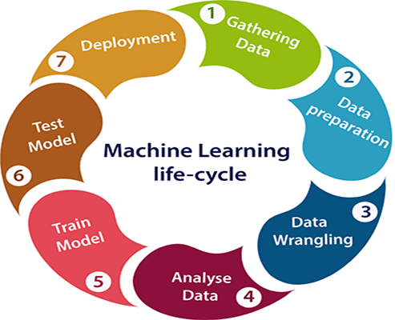
What is Machine Learning?

Slide 11
General structure of a learning system
Learning system
Data
Learning
Process
Feed-back
Problem Solving
Teacher
Results
Performance
Evaluation

Slide 12
Advantages of ML
Solving vision problems through statistical inference.
Intelligence from the common sense AI.
Reducing the constraints over time achieving complete autonomy.

Slide 13
Disadvantages of ML
Application specific algorithms.
Real world problems have too many variables and sensors might be too noisy.
Computational complexity.

Slide 14
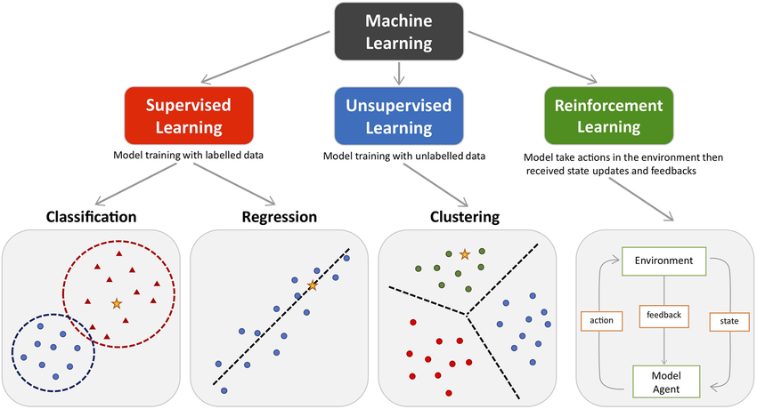
Types of machine Learning

Slide 15
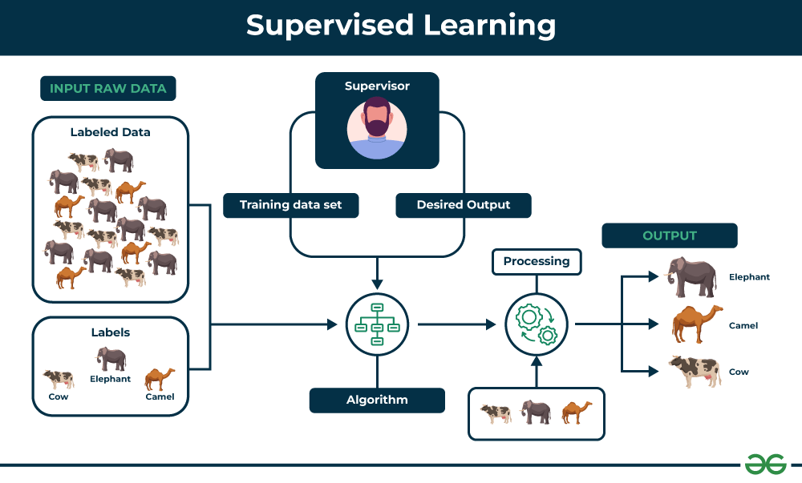
Supervides Learning

Slide 16
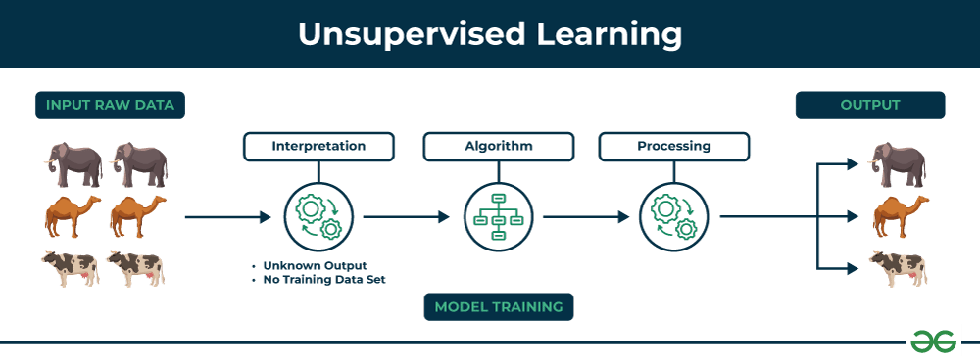
Unsupervised Learning

Slide 17
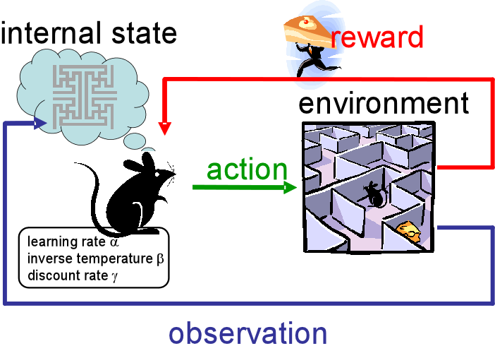
Reinforcement Learning

Slide 18
Applications
of
Machine Learning

Slide 19
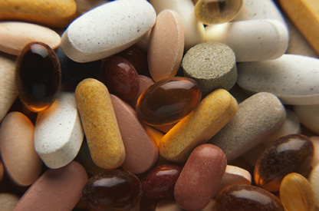
Drug discovery

Slide 20
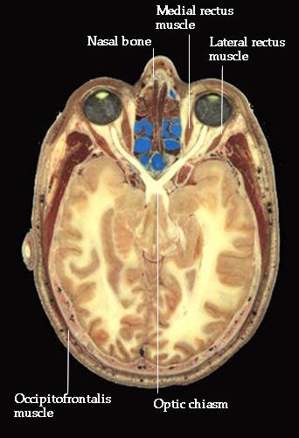
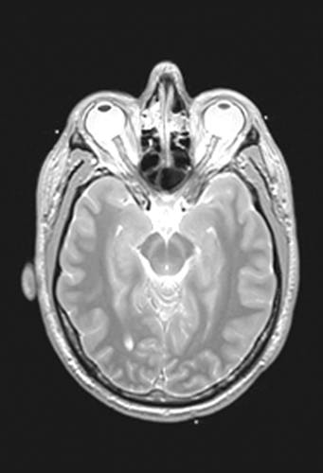
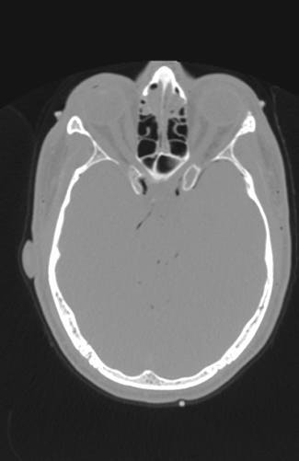
Medical diagnosis
Photo
MRI
CT

Slide 21
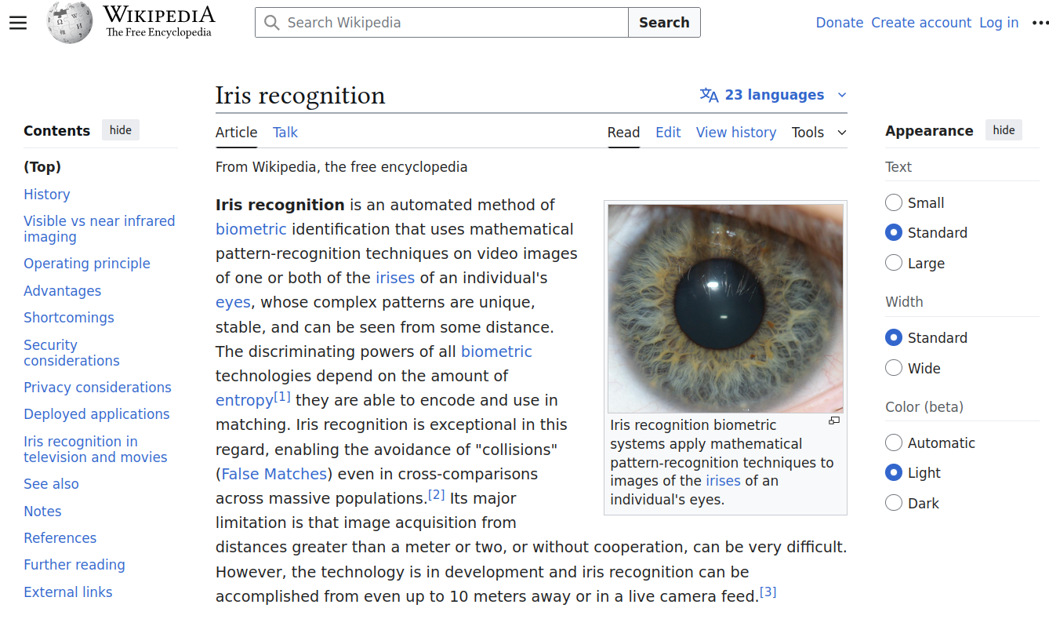
Iris verification

Slide 22

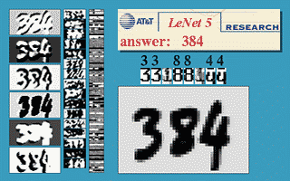
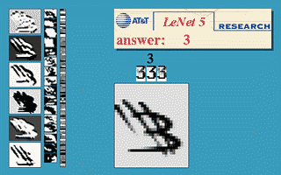
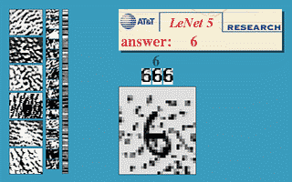

Slide 23
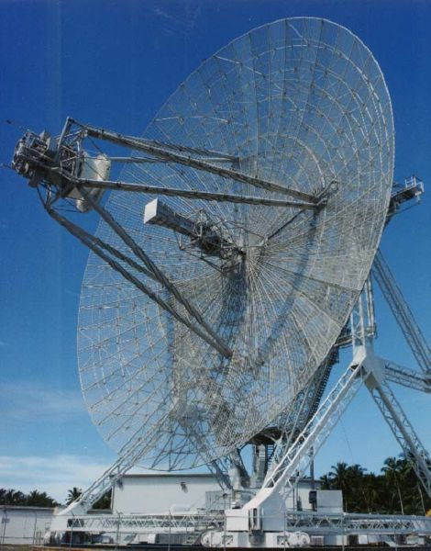
Radar Imaging

Slide 24
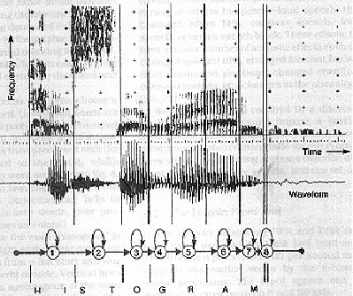
Speech Recognition

Slide 25
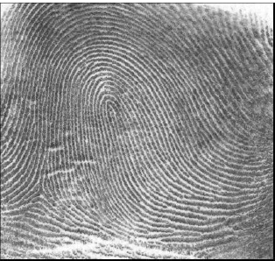
Finger print
fingerprint image

Slide 26

Signature Verification

Slide 27
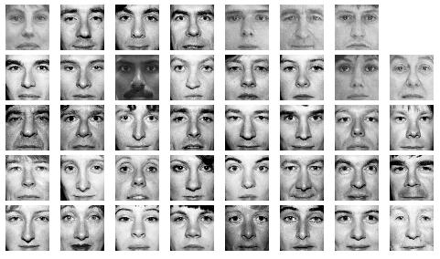
Face Recognition

Slide 28
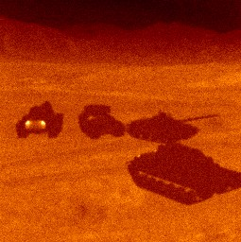
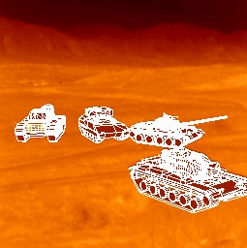
Target Recognition

Slide 29
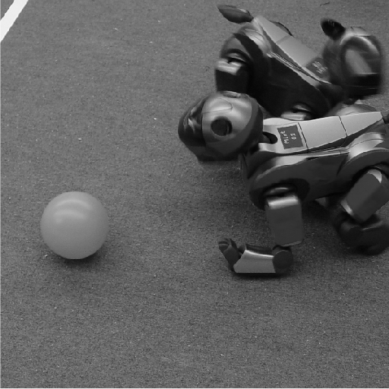
Robotics vision

Slide 30
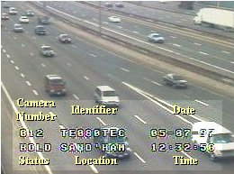
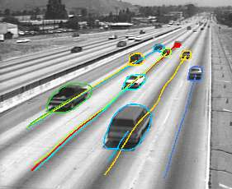
Traffic Monitoring

Slide 31
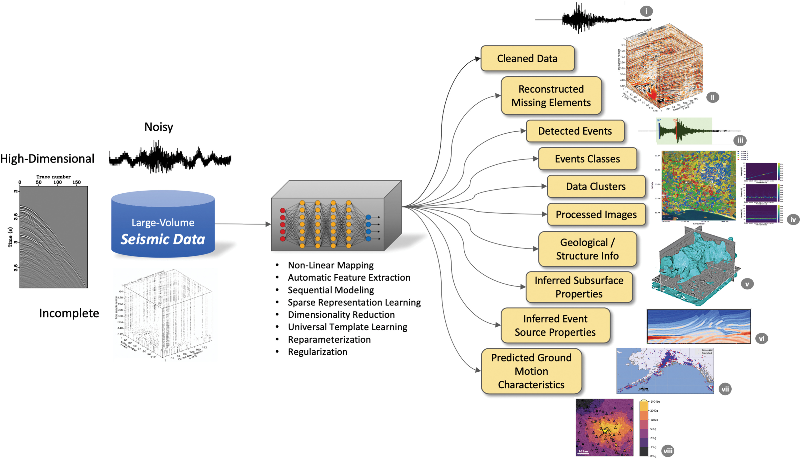

Slide 32
